Slide 1

Crisis Management: Frameworks & Principles
Stability, Leadership, and Controlled Activation Under Pressure
Crisis management provides structured leadership during high-pressure events
It protects stakeholder confidence when normal response is insufficient
It bridges executive authority with operational execution
It prioritizes stabilization before technical recovery
It enables disciplined, defensible decision-making
Notes:
Provides structure during high-pressure events Protects stakeholder confidence under stress Bridges leadership authority to execution Prioritizes stabilization before recovery Enables disciplined decision-making consistently
Example: Leadership coordinates during a citywide blackout. Cyber example: Executives lead communication during major breach.

Slide 2
CLASS AGENDA
CLASS OBJECTIVES
What crisis management is
Crisis vs incident vs disaster
Command structure and roles
Activation and escalation flow
Stabilization and readiness
Understand when crisis activation is required
Learn how structure replaces improvisation
Recognize stabilization as a leadership outcome
See how readiness precedes execution
Prepare for activation in the lab

Slide 3
Crisis Definition & Purpose
Nature of a Crisis
Why It Exists
A structured response when normal incident handling is not enough
Triggered by governance or confidence impact
Leadership-led rather rather than technician-led
Stabilization is the first intentional outcome
Involves high stakes, significant uncertainty, and time pressure
Built on control, clarity, and legitimacy
Requires a strategic, coordinated effort across multiple departments
Addresses situations that threaten the organization's core functions or survival
Focuses on protecting reputation, assets, and stakeholder trust
Provides a clear framework for decision-making under extreme pressure
Notes:
Crisis exceeds normal incident capacity Leadership drives coordinated stabilization Uncertainty and time pressure increase risk Protects reputation and organizational legitimacy Enables strategic decisions under pressure
Example: A product failure triggers executive intervention. Cyber example: Massive data breach triggers crisis declaration.

Slide 4

Command Structure & Roles
Executives define direction and escalation scope
Response teams perform stabilization actions
Communications protects stakeholder trust
Legal and HR manage governance and risk exposure
Clear structure prevents confusion under pressure
Notes:
Executives define direction and escalation Teams perform stabilization actions Communications maintain stakeholder trust Legal manages exposure and compliance Structure prevents confusion under pressure
Example: Leadership assigns clear roles during outage. Cyber example: Legal and security align breach actions.

Slide 5
Event Classification
Operational Events
Crisis Conditions
Incidents disrupt but remain within routine response.
Crisis escalates to strategic/leadership
Disasters involve major capability/facility loss.
Requires executive activation and often involves C-suite leadership.
Typically managed by established standard operating procedures (SOPs) and response teams.
The key distinction is significant impact to confidence, reputation, and stakeholder trust.
Impact is often localized, contained, and predictable.
Recovery efforts are usually short-term and within defined budgets.
Often unpredictable, with potential for widespread, systemic impact.
Requires deviation from routine protocols and innovative problem-solving.
Notes:
Incidents stay within routine response Disasters cause major capability loss Crisis impacts reputation and confidence Scale does not define severity Leadership activates only for governance risk
Example: Facility damage becomes disaster-level event. Cyber example: Widespread breach escalates to crisis.

Slide 6

Activation Thresholds
Pre-defined triggers prevent hesitation or overreaction
Authority is activated based on impact, not emotion
Escalation becomes a formal governance decision
Activation establishes scope and cadence
Readiness determines timing
Notes:
Triggers prevent hesitation and panic Impact defines escalation, not emotion Governance controls activation timing Scope established through formal declaration Readiness guides upward activation
Example: Leader escalates after repeated failures. Cyber example: Containment loss triggers crisis activation.

Slide 7

Activation Flow (Leadership → Command → Execution)
Detection identifies a potential escalation
Assessment verifies crisis-level impact
Authority is formally declared
Command structure convenes
Execution begins under stabilization priorities
Notes:
Detection identifies potential escalation Assessment confirms crisis severity Authority formally declares escalation Command structure convenes quickly Execution begins with stabilization focus
Example: Manager escalates after system outages spread. Cyber example: CISO declares crisis after breach expands.

Slide 8
Immediate Priorities
Prevent further degradation
Restore confidence and control
Ensure safety of personnel and assets
Secure critical infrastructure and systems
Mobilize necessary resources and expertise
Execution Outcomes
Replace reactivity with rhythm
Establish risk boundaries
Enable the transition to recovery
Maintain situational awareness and clear communication
Preserve organizational reputation and trust
Notes:
Prevent further incident degradation Restore control and confidence Ensure personnel safety immediately Protect critical infrastructure assets Mobilize necessary resources rapidly
Example: Team evacuates building during fire risk. Cyber example: Security isolates compromised systems.

Slide 9

Assurance & Readiness
Readiness is proven ahead of time, not improvised
Leaders gain confidence through rehearsal
Documentation creates defensibility
Stakeholders judge competence through coordination
Maturity is visible in disciplined activation
Notes:
Readiness proven before real events Rehearsal strengthens leadership confidence Documentation ensures defensible actions Stakeholders judge coordination quality Maturity visible through disciplined activation
Example: Training drill reassures leadership ability. Cyber example: Breach rehearsal validates escalation steps.

Slide 10

Summary & Key Takeaways
Effective leadership: foundational for decision-making and coherent crisis direction.
Structured activation: formal, disciplined, and clear transition for swift, organized response.
Rapid stabilization: primary objective, demonstrating regained control and mitigated impact.
Transparent, consistent communication: protects confidence, maintains trust, and minimizes uncertainty.
Proven readiness: demonstrated capability through rigorous planning, rehearsals, and continuous validation.
Continuous improvement: integrating lessons learned for long-term resilience and enhanced future response.

Slide 11
BREAK TIME
Be back in 15 mins.
Notes:
https://www.ncsc.gov.uk/static-assets/documents/PwnedPasswordsTop100k.txt

Slide 12

Crisis vs. Incident vs. Disruption
Understanding Impact Tiers and Escalation Boundaries
Disruptions, incidents, and crises are different levels of impact, not interchangeable terms
Proper classification determines who leads, what activates, and how governance responds
Operational volume does not define severity — impact to confidence does
Misclassification leads to escalation errors and delayed stabilization
Understanding thresholds is the foundation of disciplined response
Notes:
Disruptions absorbed by frontline teams Incidents require structured coordination Crisis threatens legitimacy and trust Severity defined by confidence impact Escalation discipline protects governance
Example: Minor outage ignored by executives. Cyber example: SLA breach becomes incident, not crisis.

Slide 13
CLASS AGENDA
CLASS OBJECTIVES
What is a disruption
What is an incident
What is a crisis
Escalation thresholds
Why classification matters
Separate low-level noise from true operational impact
Understand when leadership is required
Recognize crisis as a governance decision
Improve escalation discipline
Strengthen organizational maturity

Slide 14
What is a Disruption?
Definition & Nature
Implications & Management
A disruption is a minor disturbance that interrupts normal flow
Logged and handled as routine operational noise
No structural or governance visibility required
It is usually absorbed by frontline or routine operational teams
Recovery is handled through standard procedures
Does not activate coordination structures
A workaround is typically available without escalation
Serves as early signal monitoring before escalation
Impact is localized rather than systemic
Time sensitivity is low and response is reversible
Notes:
Minor disturbance with limited impact Handled by normal operations teams Workarounds usually available immediately Impact remains localized and reversible No governance involvement required
Example: Short Wi-Fi drop affects one room. Cyber example: Temporary laptop issue resolved quickly.

Slide 15

Disruption Examples
Temporary slowdown with little user impact
Minor service glitch corrected quickly
Local device/network fault
Short-lived degradation with workaround
No executive awareness needed
Notes:
Temporary slowdown without major effects Minor glitch corrected quickly Local equipment fault resolved fast Short degradation with quick workaround No executive awareness needed
Example: Printer outage slows small team briefly. Cyber example: Local switch reboot restores connectivity.

Slide 16
What is an Incident?
Definition & Drivers
Implications & Response
An incident causes measurable operational impact
Ownership shifts to incident response leadership
Requires structured coordination beyond local teams
Priorities are actively managed and documented
May affect customer experience or service levels
Impact communication becomes relevant
Workarounds may exist but require managed effort
Restoration is the goal, not long-term governance action
Time matters more and escalation thresholds apply
If degradation accelerates, it can escalate to crisis review
Notes:
Operational impact becomes measurable Requires structured coordination response Affects customers or service levels Workarounds require management oversight Escalation thresholds begin to apply
Example: Payment system outage delays service. Cyber example: API failure impacts multiple clients.

Slide 17

Incident Examples
Service slowdown affecting multiple users
Outage tied to a production component
Containment or failover required
SLA impact potential
Elevated visibility within operations
Notes:
Service slowdown affecting many users Outage tied to key component Containment or failover required Potential SLA breach emerges Visibility rises across operations
Example: Checkout lines stall across stores. Cyber example: Database cluster slows transactions.

Slide 18

Escalation Boundary
The line between incident and crisis is governance impact
Operational recovery is still possible during an incident
Crisis begins when legitimacy or confidence is threatened
Scale alone does not define crisis severity
Leadership activation marks the shift
Notes:
Boundary defined by governance impact Operational recovery still possible Crisis begins when trust threatened Scale does not determine severity Leadership activation marks transition
Example: Negative media attention shifts impact. Cyber example: Breach exposes customer data widely.

Slide 19
What is a Crisis?
Definition & Triggers
Implications & Consequences
A crisis threatens confidence, legitimacy, or governance
Stabilization becomes the first priority
Requires executive visibility and leadership authority
Communications is now risk-bearing, not informational
Escalation is strategic, not operational
Incorrect handling expands impact beyond operations
Time pressure interacts with reputational risk
Demonstrates organizational maturity
Notes:
Threatens confidence and legitimacy Requires executive leadership authority Escalation becomes strategic decision Reputation risk becomes dominant Stabilization becomes primary objective
Example: Major scandal forces executive action. Cyber example: Nation-state attack hits critical systems.

Slide 20
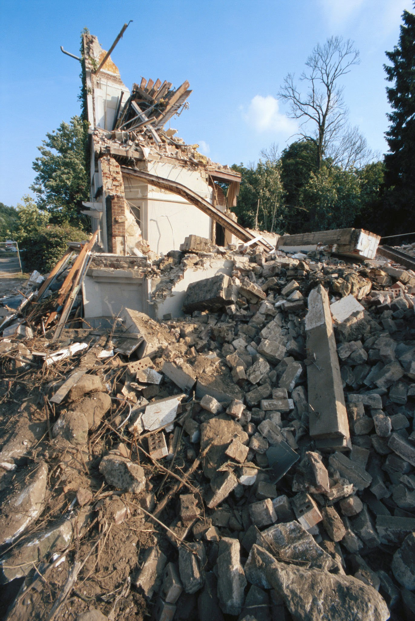
Crisis Examples
Customer trust degradation
Legal or compliance exposure
Executive or board intervention
Severe stakeholder uncertainty
Public or reputational fallout
Notes:
Customer trust rapidly deteriorates Legal exposure emerges suddenly Executive intervention required immediately Stakeholder uncertainty becomes severe Reputational fallout escalates quickly
Example: Product recall triggers media storm. Cyber example: Data leak hits national news.

Slide 21

Summary & Key Takeaways
Disruption is merely organizational noise, not a direct threat to core operations.
An incident signifies a managed operational impact that can be resolved with standard protocols.
A crisis represents a severe, governance-level threat requiring immediate executive intervention.
Accurate classification is crucial for protecting the quality and effectiveness of our response.
Escalation to crisis level is a strategic maturity decision, not an automatic reaction.
Proactive communication builds resilience and maintains critical stakeholder confidence.
Continuous learning from past events significantly enhances future crisis preparedness.

Slide 22
BREAK TIME
Be back in 15 mins.
Notes:
https://www.ncsc.gov.uk/static-assets/documents/PwnedPasswordsTop100k.txt

Slide 23

Activation Criteria for Declaring a Crisis
From Warning Signs to Executive Activation
Crisis activation is a decision, not a reaction
Criteria ensure escalation happens with discipline, not panic
Correct classification preserves trust and authority
Thresholds prevent premature or delayed activation
Leaders must know when control must shift upward

Slide 24
CLASS AGENDA
CLASS OBJECTIVES
Pre-activation conditions
Early warning signals
Hard trigger thresholds
Leadership decision gates
Stabilization readiness
Understand prerequisites to escalation
Distinguish soft signals from hard triggers
Recognize when leadership must assume authority
Strengthen escalation discipline
Link activation to stabilization outcomes

Slide 25
Pre-Activation Conditions
Preconditions / Environment
Role / Detection Perspective
Normal escalation is still functioning at incident level
Frontline identifies instability risk
Operational teams still hold primary control
Repeated disruptions signal brewing escalation
No governance exposure yet
Workarounds exist and are stabilizing conditions
Incident command begins to track patterns
Localized visibility, not organizational
Risk is monitored, not declared
Readiness posture quietly increases
Notes:
Incident response still functioning locally No governance exposure identified Workarounds still stabilizing impact Visibility stays limited and contained Risk monitored without declaration
Example: Team handles repeated small outages. Cyber example: SOC tracks unusual activity trends.

Slide 26

"Not Yet a Crisis"
Operationally uncomfortable but still manageable
No reputational exposure
Correctable through established playbooks
Stabilization still likely without escalation
Leadership informed, not activated
Notes:
Uncomfortable but operationally manageable No reputational exposure visible Standard playbooks still effective Stabilization remains likely soon Leadership informed but inactive
Example: Systems slow but still functional. Cyber example: Contained malware not spreading.

Slide 27
Early Warning Signals + Trigger Criteria
Early Warning Signals
Hard Activation Triggers
Sustained degradation beyond normal tolerance
Loss of confidence in containment
Dependencies begin compounding risk
Threat to legitimacy or governance
Containment losing effectiveness
Reputation or trust exposure
Escalation cadence shortens
Structural impact beyond a single domain
Internal concern begins to rise
Multi-domain synchronization now required
Notes:
Degradation exceeds normal tolerance Dependencies begin compounding risk Containment effectiveness dropping fast Escalation cadence shortens noticeably Internal concern rising steadily
Triggers Loss of confidence in containment Threat to legitimacy or governance Reputation exposure increases sharply Impact spreads beyond one domain Multi-domain coordination required
Example: Small issues spread across departments. Cyber example: Lateral movement suggests containment loss.

Slide 28

Escalation Momentum
Pressure moves from technical to strategic
Coordination shifts from horizontal to vertical
Leadership attention converts to intervention
Time risk begins outweighing technical risk
The "window to decide" begins closing
Notes:
Pressure shifts to strategic concerns Coordination becomes vertical quickly Leadership attention intensifies sharply Time pressure increases decision urgency Decision window narrows rapidly
Example: Leadership notified after widespread outages. Cyber example: Attack pace forces immediate escalation.

Slide 29

Decision Gate Posture
Leadership can no longer stay observational
Delay increases harm
Silence signals loss of control
Formal command must be activated
Governance framing replaces execution framing
Notes:
Leadership must act decisively now Delay increases harm considerably Silence signals loss of control Authority shifts upward formally Governance reframes response approach
Example: Executive steps in to halt delays. Cyber example: CISO takes command after escalation.

Slide 30
Executive Activation Decision
Decision Logic
Consequences of Activation
Crisis is declared when confidence, not availability, is at risk
Stabilization becomes first success metric
Governance lens overrides technical lens
Authority must be visible and formal
Communication cadence is now leadership-owned
Escalation shifts from fixing to stabilizing trust
Command replaces coordination
Accountability shifts upward
Recovery planning becomes secondary until control is re-established
Notes:
Confidence, not availability, drives escalation Authority must be visible externally Stabilization becomes primary metric Governance lens overrides operations Recovery secondary until control restored
Example: CEO addresses staff after major failure. Cyber example: Executive leads breach announcement.

Slide 31

Governance Consequences
Executive ownership is now active
Narrative risk must be managed
Stakeholder perception becomes outcome-critical
Legitimacy is now the metric
Response becomes part of organizational memory
Notes:
Executive ownership formally activated Narrative risk must be managed Stakeholder perception becomes critical Legitimacy becomes performance metric Response becomes historic record
Example: Board reviews leadership decisions closely. Cyber example: Regulators audit breach communication.

Slide 32

Summary & Key Takeaways
Activation is a leadership threshold, not a technical one
Soft signals warn early; hard triggers confirm escalation
A crisis is declared to protect confidence, not systems
Decision timing affects legitimacy and containment
Authority must be formal and visible once activated
Stabilization precedes recovery every time
Escalation maturity reflects organizational discipline

Slide 33
BREAK TIME
Be back in 15 mins.
Notes:
https://www.ncsc.gov.uk/static-assets/documents/PwnedPasswordsTop100k.txt

Slide 34

CMT Roles, Escalation Protocols, and Reporting
Defining Who Acts, Who Escalates, and Who Must Be Informed
The CMT is activated when authority must shift upward
Escalation roles remove hesitation under pressure
Command replaces coordination when crisis is declared
Reporting sustains legitimacy during uncertainty
Governance becomes the stabilizing force

Slide 35
CLASS AGENDA
CLASS OBJECTIVES
Role structure
Pre-activation posture
Escalation mechanics
Command transfer
Reporting layers
Understand control pre-crisis
Know when escalation must happen
Clarify transfer of decision authority
Link reporting to governance functions
Elevate crisis leadership maturity

Slide 36
Roles Before Activation
Operational containment remains local
Observation precedes escalation
Incident lead directs response
Accountability is horizontal
Business owner tracks exposure
Authority stays at functional level
Governance is not yet invoked
Readiness is not command
Teams monitor stability conditions
Visibility remains tactical
Notes:
Containment stays local initially Incident lead manages operational impact Business owner tracks consequences Governance not yet invoked Teams monitor stability signs
Example: Ops team handles recurring failures. Cyber example: SOC manages early intrusion signs.

Slide 37
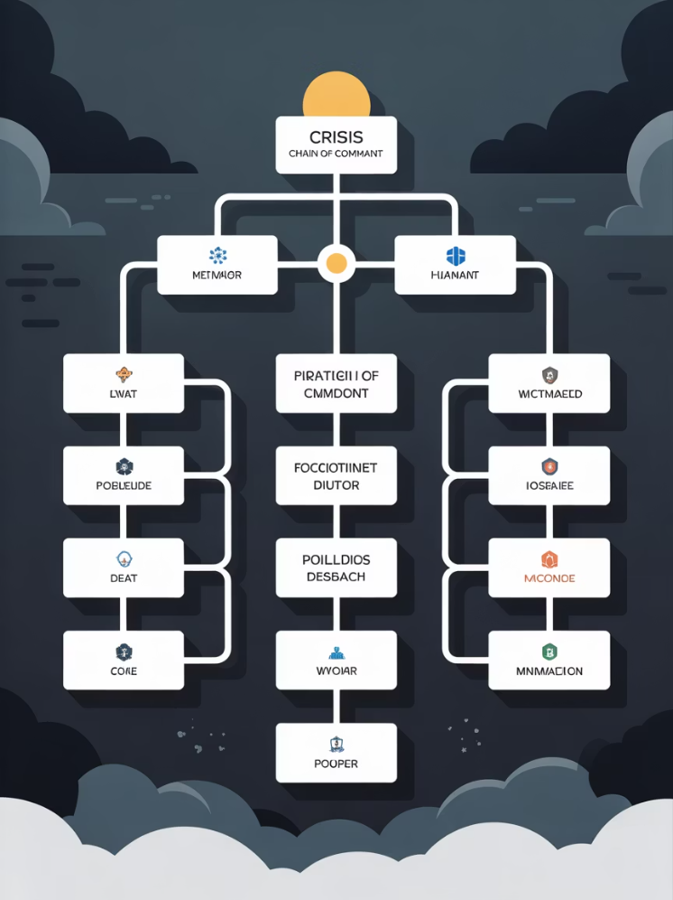
CMT Role Context
CMT governs response structure, not execution
Command shifts from horizontal to vertical
Legitimacy becomes part of containment
Confidence becomes a deliverable
Crisis = governance activation
Notes:
CMT governs structure, not execution Command becomes vertical under crisis Legitimacy influences containment approach Confidence becomes key deliverable Crisis equals governance activation
Example: Leadership takes control during escalation. Cyber example: CISO leads coordinated breach response.

Slide 38
Escalation Protocols During Activation
Authority formally transfers upward
Incident lead signals escalation
Command cadence replaces coordination
CMT validates scope/severity
Declaration marks control change
Thresholds justify activation
Timing is a governance safeguard
Leadership becomes accountable
Visibility becomes executive-level
Escalation is documented posture
Notes:
Authority formally shifts upward Command cadence replaces coordination Declaration signals structural change Leadership validates event severity Escalation must be documented clearly
Example: Exec team convenes after escalation call. Cyber example: Crisis bridge opened after breach spread.

Slide 39

Operational -> Strategic Shift
Response objective becomes confidence
Leadership directs stabilization
Communication becomes control
Delay magnifies risk
CMT becomes decision center
Notes:
Confidence becomes main objective Leadership directs stabilization steps Communication becomes control mechanism Delay rapidly increases risk CMT becomes decision center
Example: Leaders manage staff communication tightly. Cyber example: Security hands control to executive team.

Slide 40

Decision Authority
Advisory posture ends at activation
Silence signals uncertainty
Command stabilizes perception
Governance replaces execution
Authority must be visible
Notes:
Advisory posture ends immediately Silence becomes harmful signal Command stabilizes perception quickly Governance replaces execution authority Leadership must be visible consistently
Example: Executive speaks to organization immediately. Cyber example: CISO publicly confirms breach status.

Slide 41
Reporting After Activation
Internal
External
CMT briefs executives first
Stakeholders become the audience
Messaging becomes aligned
Visibility prevents speculation
Precision over volume
Reporting protects legitimacy
Cadence becomes structured
Trust becomes outcome
Accountability clarified
Communication is governance
Notes:
Executives briefed with precision Messaging aligned across teams Cadence structured for consistency Stakeholders receive timely updates Communication becomes governance tool
Example: Internal updates shared hourly. Cyber example: Customers notified in controlled cadence.

Slide 42

Why Reporting Matters
Reporting preserves confidence
Structure prevents narrative drift
Communication reinforces authority
Perception shapes impact
Transparency signals control
Notes:
Reporting preserves stakeholder confidence Structure prevents message drift Communication reinforces authority Perception shapes crisis impact Transparency signals strong control
Example: Clear updates stop rumors quickly. Cyber example: Accurate breach updates reduce panic.

Slide 43

Summary & Key Takeaways
CMT readiness exists before command transfer
Escalation activates leadership authority
Crisis = governance, not execution
Confidence becomes the primary objective
Reporting sustains legitimacy
Alignment precedes communication
Leadership posture defines control

Slide 44
BREAK TIME
Be back in 15 mins.
Notes:
https://www.ncsc.gov.uk/static-assets/documents/PwnedPasswordsTop100k.txt

Slide 45

Coordination with Emergency Services, Regulators, and Public Stakeholders
Building trust-based crisis partnerships before and during disruption.
This presentation explores the critical importance of establishing collaborative relationships with key stakeholders before crisis events occur, ensuring coordinated response and maintaining public trust during emergencies.
Understand why coordination prevents isolated decision-making
Recognize how shared action reduces operational losses
Learn how authority partnerships improve safety outcomes
Appreciate how visible collaboration builds crisis credibility

Slide 46
CLASS AGENDA
CLASS OBJECTIVES
Why coordination matters
Emergency services interaction
Regulator expectations
Public stakeholder engagement
Readiness before activation
Clarify external relationships in crisis
Understand who takes tactical control
Recognize legal and regulatory timing
Preserve credibility with the public
Build trust before disruption

Slide 47
Consequences of Fragmentation
When coordination fails, organizations face cascading challenges that compound crisis impact and undermine recovery efforts.
Operational Failures
Strategic Consequences
Slow response handoffs
Reputational erosion
Conflicting instructions
Coordination breakdown
Missed escalation windows
Oversight scrutiny
Resource misalignment
Loss of trust
External confusion
Credibility collapse
Notes:
Slow handoffs increase operational delays Conflicting instructions confuse responders Missed escalation windows worsen impact Resource misalignment disrupts response External confusion damages reputation
Example: Agencies receive contradictory updates. Cyber example: IT and security misalign containment steps.

Slide 48

Coordination with Emergency Services
Emergency services coordination involves establishing clear contact protocols and response procedures with local law enforcement, fire departments, and first responders to ensure rapid, effective crisis response.
Used when life, safety, or property is at risk
First responders assume tactical control on site
Pre-designated liaisons reduce delay
Accurate situational briefings speed resolution
Notes:
Used when safety is at risk First responders take tactical lead Liaisons reduce response delays Clear briefings improve effectiveness Coordination accelerates overall resolution
Example: Fire crew takes control onsite. Cyber example: Police involved during cyber extortion.

Slide 49
Coordination with Regulators and Authorities
Emergency management coordination involves working with regulatory agencies and following established protocols for incident reporting and response to ensure compliance and proper oversight.
Certain impacts require mandatory notification
Timing of disclosure is monitored
Oversight is triggered by severity
Traceability of decisions is expected
Notes:
Some impacts require mandatory reports Disclosure timing closely monitored Oversight triggered by event severity Traceability expected at every step Regulators evaluate organizational posture
Example: Reported outage meets legal requirements. Cyber example: Data breach notification submitted promptly.

Slide 50

Coordination with Public Stakeholders
Crisis communication plans ensure clear, timely information sharing with residents and external partners during emergencies to manage and mitigate crisis impact while maintaining public confidence.
Communities expect consistent, stable updates
Customers require confidence in continuity
Tone influences trust retention
External transparency signals control
Notes:
Public expects clear updates regularly Customers require continuity assurance Tone influences trust retention Transparency signals strong control External communication shapes legitimacy
Example: Community updates reduce uncertainty. Cyber example: Breach FAQ reassures customers.

Slide 51
Where Coordination Fails
Poor coordination creates vulnerabilities that amplify crisis impact and extend recovery timeframes, often resulting from inadequate preparation and unclear responsibilities.
Communication Breakdowns
Operational Gaps
Late involvement of authorities
Mismatched timelines
Conflicting public messages
Unclear points of contact
Disconnected escalation paths
Absent status handoffs
Internal vs external narrative gaps
Delayed situational clarity
Overlapping responsibilities
Reactive posture
Notes:
Late authority involvement delays action Conflicting messages confuse audiences Disconnected escalation pathways emerge Internal narratives differ externally Responsibilities overlap without clarity
Example: Departments send mixed instructions. Cyber example: Security and PR contradict timelines.

Slide 52

Building Relationships Before a Crisis
Establishing working relationships with emergency agencies and experts before incidents occur facilitates efficient response efforts and strengthens coordination capabilities when time is critical.
Pre-crisis trust accelerates activation
Coordination mapping prevents conflict
Shared expectations reduce hesitation
Familiarity strengthens joint response
Notes:
Pre-crisis trust accelerates response Coordination mapping prevents conflict Shared expectations reduce hesitation Familiarity strengthens collaboration Preparedness improves joint outcomes
Example: Fire drill includes local responders. Cyber example: CISO builds ties with regulators early.

Slide 53
Communication Discipline
Effective crisis communication requires baseline messaging that explains the situation and response actions while providing clear instructions to stakeholders and maintaining coordinated information flow.
Message Control
Trust Building
Consistent tone
Avoids contradiction
Synchronized messaging
Builds confidence
Single source of truth
Reduces speculation
Clarity over volume
Reinforces readiness
Timely updates
Protects credibility
Notes:
Maintain consistent messaging tone Align updates across channels Use single source of truth Prioritize clarity over volume Timely updates sustain confidence
Example: Company provides unified public statement. Cyber example: SOC updates feed central communication.

Slide 54
Certification Expectations
Professional emergency management standards require documented coordination plans, clear roles, and tested procedures to demonstrate organizational preparedness and response capability.
Documentation Requirements
Maturity Indicators
Predefined channels
Maturity evidence
Documented liaisons
Traceable steps
Recorded decisions
Role consistency
External participation
Interoperable plans
Repeatable structure
Tested reliability
Notes:
Documentation must show clear channels Liaisons formally designated before events Decisions recorded for traceability External participation demonstrated Plans tested for interoperability
Example: Agency review confirms prepared procedures. Cyber example: Regulators assess breach documentation.

Slide 55

Summary & Takeaways
Effective coordination with emergency services, regulators, and public stakeholders requires proactive relationship building and disciplined communication to ensure successful crisis response.
Coordination cannot start at the moment of crisis
Trusted partnerships determine response speed
Emergency services bring operational authority
Regulators ensure lawful execution
Public stakeholders shape legitimacy
Discipline prevents narrative drift
Preparation defines credibility

Slide 56
Lab Time
1 Hour
Notes:
https://www.ncsc.gov.uk/static-assets/documents/PwnedPasswordsTop100k.txt

Slide 57
Workshop
1 Hour
Notes:
https://www.ncsc.gov.uk/static-assets/documents/PwnedPasswordsTop100k.txt

Slide 58

Crisis Management: Core Concepts Recap
Leadership, Thresholds, and Governance Alignment
Crisis Management Frameworks & Principles
Crisis management is leadership-driven, not technician-driven
Focuses on stability, legitimacy, and confidence under pressure
Structures decision authority during uncertainty
Stabilization precedes technical recovery
Governance defines how crisis posture activates
Governance Anchor: "Crisis management exists to protect legitimacy and confidence when normal response is insufficient."
Notes:
Leadership drives crisis direction Stability prioritized before recovery Decision authority becomes structured Confidence protected through governance Crisis activation guided by thresholds
Example: Leader stabilizes chaos during shutdown. Cyber example: Executives guide breach containment.

Slide 59

Crisis vs. Incident vs. Disruption
Disruptions are minor and absorbed by operations
Incidents require structured coordination
Crisis = governance exposure and loss of confidence
Severity is defined by trust impact, not technical volume
Escalation discipline protects legitimacy
Governance Anchor: "A crisis is defined by governance impact, not outage size."
Notes:
Disruptions remain operational noise Incidents require structured coordination Crisis impacts confidence significantly Severity measured by trust risk Escalation discipline protects legitimacy
Example: Customer confusion marks escalation point. Cyber example: Breach becomes crisis after exposure.

Slide 60
Activation Criteria for Declaring a Crisis
Activation is a decision, not a reaction
Hard triggers = legitimacy and confidence risk
Leadership must become visible and accountable
Timing is a governance safeguard
Stabilization replaces containment as the first outcome
Governance Anchor: "Crisis activation exists to protect confidence before operational failure expands."
Notes:
Activation is leadership decision Triggers tied to confidence loss Authority must become visible Timing protects organizational legitimacy Stabilization prioritized above recovery
Example: CEO engages before crisis worsens. Cyber example: Executive declares crisis during breach.

Slide 61
CMT Roles, Escalation Protocols, and Reporting
CMT governs structure once authority shifts upward
Command replaces coordination
Escalation removes hesitation
Reporting preserves legitimacy
Confidence becomes the central deliverable
Governance Anchor: "Escalation is the moment governance becomes operational."
Notes:
CMT controls structure and authority Escalation removes hesitation quickly Reporting protects organizational legitimacy Confidence becomes key outcome Governance frames every decision
Example: CMT anchors staff communication. Cyber example: Unified updates minimize reputational harm.

Slide 62

Coordination with Emergency Services & Stakeholders
External partners provide tactical legitimacy
Regulators define lawful posture and oversight
Public stakeholders shape perception outcomes
Pre-crisis relationships accelerate stabilization
Visibility and coordination preserve trust
Governance Anchor: "Crisis credibility is earned through external alignment, not internal intent."
Notes:
External partners strengthen legitimacy Regulators ensure lawful execution Public perception shapes outcomes Pre-crisis alignment accelerates response Visibility reinforces trust continuity
Example: Fire department partnership improves response. Cyber example: Regulator communication stabilizes fallout.

Slide 63
Kahootz & Quiz Time
Notes:
https://www.ncsc.gov.uk/static-assets/documents/PwnedPasswordsTop100k.txt

